Slide 1
INTRODUCTION TO DATA MINING ONLINE NEWS POPULARITY
Prepared by:
Mohammad Affan Sheikh 13186
Mishaal Hajiani 13050

Slide 2
OUTLINE OF THE STUDY:
The topic we have chosen is “Online News Popularity”.
This dataset has been picked from an online website named, UCI-Machine Learning Repository.
There were all together 61 factors available that were claimed to affect the number of shares of an article.
DATA SET INFORMATION:
This dataset summarizes a heterogeneous set of features about articles published by Mashable in a period of two years.
PROBLEM IN HAND:
The organization(www.mashable.com) wants to evaluate the popularity of an article and the structure of it. The study is going to help in understanding the key factors that help in making an article a hit.

Slide 3
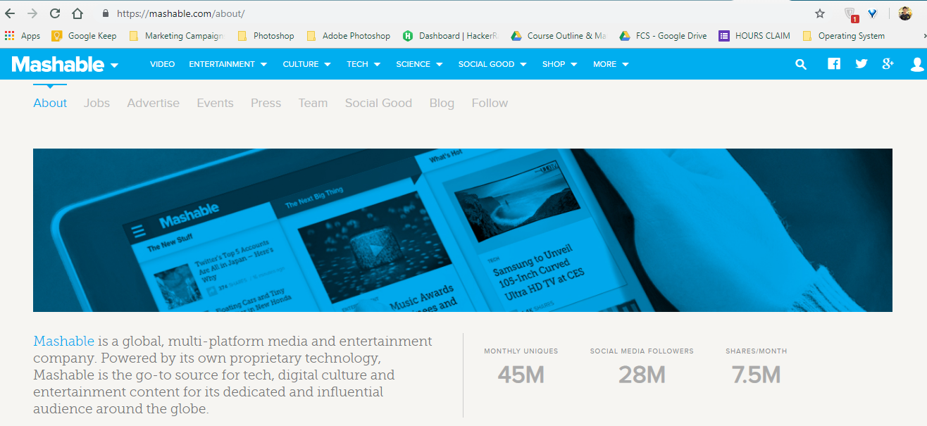
Data Analytics Life Cycle (CRISP-DM)
Step 1- Business Understanding
Mashable is a global, multi-platform media and entertainment company. Powered by its own proprietary technology, Mashable is the go-to source for tech, digital culture and entertainment content for its dedicated and influential audience around the globe.

Slide 4
How does Mashable make money?
Mashable is monetized by offering a variety of advertising formats to its 45M unique monthly readers.
How will this study boost Mashable’s Business?
The study on the respective dataset will figure out the factors that make an article go viral on the internet. Being viral means a solid amount of views, comments, likes, and shares.
Keeping in mind the business structure of the organization which earns money via advertisements, hence maximum views on an article means greater advertisement display duration which then results in generation of revenue for the firm.
This study will state what factors, for example the use of positive or negative words, images or view content, strong title, timestamp of publication, linked content etc., have the optimum involvement in making an article reach to maximum audience.

Slide 5
Step 2- DATA UNDERSTANDING
OBJECTIVES OF THE CURRENT STUDY
The goal is to predict the number of shares in social networks (popularity).
To determine the specific predators associated to gauge the popularity a news.
We are using R-statistical software to interpret the dataset.
The attributes used and their descriptions are stated in the next slide.

Slide 6
ATTRIBUTE INFORMATION:
Number of Attributes: 61 (58 predictive attributes, 2 non-predictive, 1 goal field) Attribute Information: 0. url: URL of the article (non-predictive) 1. timedelta: Days between the article publication and the dataset acquisition (non-predictive) 2. n_tokens_title: Number of words in the title 3. n_tokens_content: Number of words in the content 4. n_unique_tokens: Rate of unique words in the content 5. n_non_stop_words: Rate of non-stop words in the content 6. n_non_stop_unique_tokens: Rate of unique non-stop words in the content 7. num_hrefs: Number of links 8. num_self_hrefs: Number of links to other articles published by Mashable 9. num_imgs: Number of images 10. num_videos: Number of videos 11. average_token_length: Average length of the words in the content 12. num_keywords: Number of keywords in the metadata 13. data_channel_is_lifestyle: Is data channel 'Lifestyle'? 14. data_channel_is_entertainment: Is data channel 'Entertainment'? 15. data_channel_is_bus: Is data channel 'Business'? 16. data_channel_is_socmed: Is data channel 'Social Media'? 17. data_channel_is_tech: Is data channel 'Tech'? 18. data_channel_is_world: Is data channel 'World'? 19. kw_min_min: Worst keyword (min. shares) 20. kw_max_min: Worst keyword (max. shares) 21. kw_avg_min: Worst keyword (avg. shares) 22. kw_min_max: Best keyword (min. shares) 23. kw_max_max: Best keyword (max. shares) 24. kw_avg_max: Best keyword (avg. shares) 25. kw_min_avg: Avg. keyword (min. shares) 26. kw_max_avg: Avg. keyword (max. shares)

Slide 7
27. kw_avg_avg: Avg. keyword (avg. shares) 28. self_reference_min_shares: Min. shares of referenced articles in Mashable 29. self_reference_max_shares: Max. shares of referenced articles in Mashable 30. self_reference_avg_sharess: Avg. shares of referenced articles in Mashable 31. weekday_is_monday: Was the article published on a Monday? 32. weekday_is_tuesday: Was the article published on a Tuesday? 33. weekday_is_wednesday: Was the article published on a Wednesday? 34. weekday_is_thursday: Was the article published on a Thursday? 35. weekday_is_friday: Was the article published on a Friday? 36. weekday_is_saturday: Was the article published on a Saturday? 37. weekday_is_sunday: Was the article published on a Sunday? 38. is_weekend: Was the article published on the weekend? 39. LDA_00: Closeness to LDA topic 0 40. LDA_01: Closeness to LDA topic 1 41. LDA_02: Closeness to LDA topic 2 42. LDA_03: Closeness to LDA topic 3 43. LDA_04: Closeness to LDA topic 4 44. global_subjectivity: Text subjectivity 45. global_sentiment_polarity: Text sentiment polarity 46. global_rate_positive_words: Rate of positive words in the content 47. global_rate_negative_words: Rate of negative words in the content 48. rate_positive_words: Rate of positive words among non-neutral tokens 49. rate_negative_words: Rate of negative words among non-neutral tokens 50. avg_positive_polarity: Avg. polarity of positive words 51. min_positive_polarity: Min. polarity of positive words 52. max_positive_polarity: Max. polarity of positive words 53. avg_negative_polarity: Avg. polarity of negative words 54. min_negative_polarity: Min. polarity of negative words 55. max_negative_polarity: Max. polarity of negative words 56. title_subjectivity: Title subjectivity 57. title_sentiment_polarity: Title polarity 58. abs_title_subjectivity: Absolute subjectivity level 59. abs_title_sentiment_polarity: Absolute polarity level 60. shares: Number of shares (target)

Slide 8
Step 3- DATA PREPARATION
>trial=read.csv("E:\\OnlineNewsPopularity.csv",header=T) //dataset loaded
>trial=trial[complete.cases(trial),] // tuples with missing values removed
>modeli=lm(shares~attributei, data=trial) i=0 to 60
We did few sample t-tests to check the significance that each factor holds against y (shares) and finalized 35 factors shown below in the table
Estimate Std. Error t value Pr(>|t|)
n_tokens_title 7.182e+01 2.797e+01 2.568 0.010233 *
n_tokens_content 5.364e-01 1.912e-01 2.806 0.005017 **
n_unique_tokens 2.045e+03 8.488e+02 2.409 0.016004 *
num_hrefs 2.968e+01 6.492e+00 4.572 4.84e-06 ***
num_self_hrefs -6.353e+01 1.730e+01 -3.672 0.000241 ***
num_imgs 1.426e+01 8.251e+00 1.728 0.083916 .
average_token_length -5.092e+02 1.348e+02 -3.776 0.000160 ***
num_keywords 1.139e+02 3.266e+01 3.488 0.000488 ***
data_channel_is_lifestyleyes -1.104e+03 3.886e+02 -2.841 0.004499 **
data_channel_is_entertainmentyes-1.456e+03 2.431e+02 -5.989 2.13e-09 ***
data_channel_is_busyes -1.128e+03 3.784e+02 -2.981 0.002873 **
data_channel_is_socmedyes -7.576e+02 3.645e+02 -2.078 0.037674 *
data_channel_is_techyes -7.935e+02 3.668e+02 -2.163 0.030533 *
data_channel_is_worldyes -7.546e+02 3.688e+02 -2.046 0.040742 *
kw_avg_min 2.926e-01 1.130e-01 2.591 0.009583 **
kw_max_avg -1.145e-01 1.954e-02 -5.860 4.66e-09 ***
kw_avg_avg 1.004e+00 9.467e-02 10.602 < 2e-16 ***
self_reference_avg_shares 2.021e-02 2.442e-03 8.278 < 2e-16 ***
weekday_is_mondayyes 2.786e+02 2.626e+02 1.061 0.288591
weekday_is_tuesdayyes -2.543e+02 2.587e+02 -0.983 0.325652
weekday_is_wednesdayyes -1.010e+02 2.587e+02 -0.390 0.286278
weekday_is_thursday yes -2.682e+02 2.593e+02 -1.034 0.301024
weekday_is_fridayyes -2.342e+02 2.686e+02 -0.872 0.0383315 .
weekday_is_saturdayyes 3.727e+02 3.206e+02 1.163 0.0244999.
LDA_00 1.429e+06 5.949e+05 2.403 0.016285 *
LDA_01 1.429e+06 5.949e+05 2.401 0.016337 *
LDA_02 1.428e+06 5.949e+05 2.400 0.016401 *
LDA_03 1.429e+06 5.949e+05 2.402 0.016292 *
LDA_04 1.429e+06 5.949e+05 2.402 0.016326 *
global_subjectivity 2.649e+03 8.001e+02 3.311 0.000929 ***
global_rate_positive_words -7.757e+03 4.051e+03 -1.915 0.055530 .
global_rate_negative_words -3.750e+03 5.942e+03 -0.631 0.0527926.
avg_positive_polarity -1.350e+03 7.567e+02 -1.784 0.074477 .
avg_negative_polarity -1.647e+03 5.402e+02 -3.048 0.002306 **
title_sentiment_polarity 3.134e+02 2.247e+02 1.395 0.163039
Signif. codes: 0 ‘***’ 0.001 ‘**’ 0.01 ‘*’ 0.05 ‘.’ 0.1 ‘ ’ 1

Slide 9
Step-4 MODELLING
TYPE OF REGRESSION MODEL: Observational (values of x’s(attributes) are uncontrolled
model10<lm(shares~n_tokens_title+n_tokens_content+n_unique_tokens+num_hrefs+num_self_hrefs+num_imgs+num_videos+average_token_length+num_keywords+data_channel_is_lifestyle+data_channel_is_entertainment+data_channel_is_bus+data_channel_is_socmed+data_channel_is_tech+data_channel_is_world+kw_avg_min++kw_max_avg+kw_avg_avg+self_reference_avg_sharess+weekday_is_monday+weekday_is_tuesday+weekday_is_wednesday+weekday_is_thursday+weekday_is_friday+ weekday_is_saturday+LDA_00+LDA_01+LDA_02+LDA_03+LDA_04+global_subjectivity+global_rate_positive_words+global_rate_negative_words+avg_positive_polarity+avg_negative_polarity+title_sentiment_polarity,data = trial)
Modeling a response:
Multiple Regression: A Model Relating E(y) for Qualitative Independent Variables
E(y)= β0+β1n_tokens_title+ β2n_tokens_content+ β3n_unique_tokens+ β4num_hrefs+ β5num_self_hrefs+ β6num_imgs+ β7average_token_length+ β8num_keywords+ β9data_channel_is_lifestyle+ β10data_channel_is_entertainment+ β11data_channel_is_bus+ β12data_channel_is_socmed+ β13data_channel_is_tech+ β14data_channel_is_world+ β15kw_avg_min+ β16kw_max_avg+ β17kw_avg_avg+ β18self_reference_avg_shares+ β19weekday_is_monday+ β20weekday_is_tuesday+ β21weekday_is_wednesday+ β22weekday_is_thursday+ β23weekday_is_friday+ β24weekday_is_saturday+ β25LDA_00+ β26LDA_01+ β27LDA_02+ β28LDA_03+ β329LDA_04+ β30global_subjectivity+ β31global_rate_positive_words+ β32global_rate_negative_words+ β33avg_positive_polarity+ β34avg_negative_polarity+ β35title_sentiment_polarity+ ε
Where:
y=number of shares of an article (shares ranging from 1 to 843300)

Slide 10
Dummy variables
data_channel_is_lifestyle | data_channel_is_entertainment | data_channel_is_bus | data_channel_is_socmed | data_channel_is_tech | data_channel_is_world | weekday_is_monday
1-If Yes 0-If No | 1-If Yes 0-If No | 1-If Yes 0-If No | 1-If Yes 0-If No | 1-If Yes 0-If No | 1-If Yes 0-If No | 1-If yes 0-If not
Base case: No | Base case: No | Base case: No | Base case: No | Base case: No | Base case: No | Base Case: No
weekday_is_tuesday | weekday_is_wednesday | weekday_is_Thursday | weekday_is_friday | weekday_is_Saturday
1-If Yes 0-If No | 1-If Yes 0-If No | 1-If Yes 0-If No | 1-If Yes 0-If No | 1-If Yes 0-If No
Base case: Good | Base case: No | Base case: No | Base case: No | Base case: No

Slide 11
>Summary(model10)
Coefficients:
Estimate Std. Error t value Pr(>|t|)
(Intercept) -1.429e+06 5.950e+05 -2.401 0.016339 *
n_tokens_title 7.182e+01 2.797e+01 2.568 0.010233 *
n_tokens_content 5.364e-01 1.912e-01 2.806 0.005017 **
n_unique_tokens 2.045e+03 8.488e+02 2.409 0.016004 *
num_hrefs 2.968e+01 6.492e+00 4.572 4.84e-06 ***
num_self_hrefs -6.353e+01 1.730e+01 -3.672 0.000241 ***
num_imgs 1.426e+01 8.251e+00 1.728 0.083916 .
average_token_length -5.092e+02 1.348e+02 -3.776 0.000160 ***
num_keywords 1.139e+02 3.266e+01 3.488 0.000488 ***
data_channel_is_lifestyleyes -1.104e+03 3.886e+02 -2.841 0.004499 **
data_channel_is_entertainmentyes 1.456e+03 2.431e+02 -5.989 2.13e-09 ***
data_channel_is_busyes 1.128e+03 3.784e+02 -2.981 0.002873 **
data_channel_is_socmedyes 7.576e+02 3.645e+02 -2.078 0.037674 *
data_channel_is_techyes 7.935e+02 3.668e+02 -2.163 0.030533 *
data_channel_is_worldyes -7.546e+02 3.688e+02 -2.046 0.040742 *
kw_avg_min 2.926e-01 1.130e-01 2.591 0.009583 **
kw_max_avg -1.145e-01 1.954e-02 -5.860 4.66e-09 ***
kw_avg_avg 1.004e+00 9.467e-02 10.602 < 2e-16 ***
self_reference_avg_shares 2.021e-02 2.442e-03 8.278 < 2e-16 ***
weekday_is_mondayYes 2.786e+02 2.626e+02 1.061 0.288591
weekday_is_tuesdayYes -2.543e+02 2.587e+02 -0.983 0.325652
weekday_is_wednesdayYes -1.010e+02 2.587e+02 -0.390 0.696278
weekday_is_thursdayYes -2.682e+02 2.593e+02 -1.034 0.301024
weekday_is_fridayYes -2.342e+02 2.686e+02 -0.872 0.383315
weekday_is_saturdayYes 3.727e+02 3.206e+02 1.163 0.244999
LDA_00 1.429e+06 5.949e+05 2.403 0.016285 *
LDA_01 1.429e+06 5.949e+05 2.401 0.016337 *
LDA_02 1.428e+06 5.949e+05 2.400 0.016401 *
LDA_03 1.429e+06 5.949e+05 2.402 0.016292 *
LDA_04 1.429e+06 5.949e+05 2.402 0.016326 *
global_subjectivity 2.649e+03 8.001e+02 3.311 0.000929 ***
global_rate_positive_words -7.757e+03 4.051e+03 -1.915 0.055530 .
global_rate_negative_words -3.750e+03 5.942e+03 -0.631 0.527926
avg_positive_polarity -1.350e+03 7.567e+02 -1.784 0.074477 .
avg_negative_polarity -1.647e+03 5.402e+02 -3.048 0.002306 **
title_sentiment_polarity 3.134e+02 2.247e+02 1.395 0.163039
Signif. codes: 0 ‘***’ 0.001 ‘**’ 0.01 ‘*’ 0.05 ‘.’ 0.1 ‘ ’ 1

Slide 12
MODEL SUMMARY
The value R2 = 0.6627 is highlighted on the printout. This implies that using the independent variables, the model explains 66.27% of the total sample variation in shares, y. Thus, R2 is a sample statistic that tells how well the model fits the data and thereby represents a measure of the usefulness of the entire model.
Residual standard error: 11510 on 39608 degrees of freedom
Multiple R-squared: 0.6627 | Adjusted R-squared: 0.6041
ANOVA
F-statistic: 24.6 on 35 and 39608 DF, p-value: < 2.2e-16
TESTING THE UTILITY OF A MODEL: THE ANALYSIS OF VARIANCE F-TEST
Null hypothesis: β1 = β2 = β3 =···= β35 = 0
Alternate hypotheses: At least one of the coefficients is non-zero
The test statistic used to test this hypothesis is an F statistic, the statistical software calculates the F statistic):
Test statistic: F = (SSyy − SSE)/k /SSE/ [n − (k + 1)] = 24.6
Conclusion: Since p-value< level of significance=0.05 we will reject null hypothesis and conclude that at least one of coefficient is non-zero. (conclusion based on p-value given in the table)

Slide 13
Interaction Model: An interaction model with qualitative predictors
>cor(trial) // finding correlations between attributes (35X35 matrix)
n_tokens_title n_tokens_content n_unique_tokens
n_tokens_title 1.0000000000 0.0181596482 -5.318225e-03
n_tokens_content 0.0181596482 1.0000000000 -0.870366851
n_unique_tokens -0.0053182250 -0.870366851 1.000000e+00
n_non_stop_words -0.0047539133 0.0175117542 9.995717e-01
n_non_stop_unique_tokens -0.0054197614 0.0003732513 9.998515e-01
num_hrefs -0.0534962477 0.4230650898 -4.351648e-03
num_self_hrefs -0.0148561753 0.3046821483 6.620329e-03
num_imgs -0.8800583117 0.3426003965 1.880174e-02
average_token_length -0.0714025429 0.1677891783 2.640692e-02
num_keywords -0.0607695700 0.0728447828 -3.679451e-03
data_channel_is_lifestyle -0.0708153002 0.0375482912 -1.652873e-03
data_channel_is_entertainment 0.1327905957 0.0601997821 1.101618e-02
data_channel_is_bus -0.0239021034 -0.6001053314 -2.640237e-04
data_channel_is_socmed -0.0903939390 0.0334237025 -9.446716e-04
By observing this matrix, we picked strongly negative and strongly positive correlated attributes r=± 0.8- to ±1

Slide 14
MODEL B
>model11<lm(shares~n_tokens_title+n_tokens_content+n_unique_tokens+num_hrefs+num_self_hrefs+num_imgs+average_token_length+num_keywords+data_channel_is_lifestyle+data_channel_is_entertainment+data_channel_is_bus+data_channel_is_socmed+data_channel_is_tech+data_channel_is_world+kw_avg_min++kw_max_avg+kw_avg_avg+self_reference_avg_sharess+weekday_is_monday+weekday_is_tuesday+weekday_is_wednesday+weekday_is_thursday+weekday_is_friday+ weekday_is_saturday+LDA_00+LDA_01+LDA_02+LDA_03+LDA_04+global_subjectivity+global_rate_positive_words+global_rate_negative_words+avg_positive_polarity+avg_negative_polarity+title_sentiment_polarity+num_hrefs*num_self_hrefs+n_tokens_content*n_unique_tokens,data = trial)
E(y)= β0+β1n_tokens_title+ β2n_tokens_content+ β3n_unique_tokens+ β4num_hrefs+ β5num_self_hrefs+ β6num_imgs+ β7average_token_length+ β8num_keywords+ β9data_channel_is_lifestyle+ β10data_channel_is_entertainment+ β11data_channel_is_bus+ β12data_channel_is_socmed+ β13data_channel_is_tech+ β14data_channel_is_world+ β15kw_avg_min+ β16kw_max_avg+ β17kw_avg_avg+ β18self_reference_avg_shares+ β19weekday_is_monday+ β20weekday_is_tuesday+ β21weekday_is_wednesday+ β22weekday_is_thursday+ β23weekday_is_friday+ β24weekday_is_saturday+ β25LDA_00+ β26LDA_01+ β27LDA_02+ β28LDA_03+ β329LDA_04+ β30global_subjectivity+ β31global_rate_positive_words+ β32global_rate_negative_words+ β33avg_positive_polarity+ β34avg_negative_polarity+ β35title_sentiment_polarity+ β36num_hrefs*num_self_hrefs+ β37n_tokens_content*n_unique_tokens + ε

Slide 15
> summary(model11)
Coefficients:
Estimate Std. Error t value Pr(>|t|)
(Intercept) 5.146e+06 1.639e+06 3.139 0.001695 **
n_tokens_title 7.174e+01 2.797e+01 2.565 0.010319 *
n_tokens_content 2.503e+00 4.973e-01 5.033 4.84e-07 ***
n_unique_tokens 1.996e+03 8.500e+02 2.348 0.018884 *
num_hrefs 3.312e+01 7.358e+00 4.501 6.77e-06 ***
num_self_hrefs -7.287e+01 2.555e+01 -2.852 0.004344 **
num_imgs 8.351e+00 8.372e+00 0.997 0.318543
average_token_length -4.309e+02 1.366e+02 -3.155 0.001607 **
num_keywords 1.107e+02 3.271e+01 3.382 0.000719 ***
data_channel_is_lifestyle -1.054e+03 3.888e+02 -2.711 0.006702 **
data_channel_is_entertainment -1.350e+03 2.443e+02 -5.528 3.27e-08 ***
data_channel_is_bus -1.111e+03 3.784e+02 -2.937 0.003317 **
data_channel_is_socmed -7.849e+02 3.645e+02 -2.154 0.031284 *
data_channel_is_tech -7.697e+02 3.669e+02 -2.098 0.035929 *
data_channel_is_world -6.786e+02 3.691e+02 -1.838 0.066014 .
kw_avg_min 2.887e-01 1.129e-01 2.556 0.010595 *
kw_max_avg -1.136e-01 1.954e-02 -5.813 6.17e-09 ***
kw_avg_avg 9.986e-01 9.467e-02 10.548 < 2e-16 ***
self_reference_avg_sharess 2.022e-02 2.441e-03 8.285 < 2e-16 ***
weekday_is_monday 2.921e+02 2.625e+02 1.113 0.265894
weekday_is_tuesday -2.459e+02 2.587e+02 -0.951 0.341809
weekday_is_wednesday -8.789e+01 2.587e+02 -0.340 0.734001
weekday_is_thursday -2.616e+02 2.592e+02 -1.009 0.312956
weekday_is_friday -2.282e+02 2.686e+02 -0.849 0.395624
weekday_is_saturday 3.889e+02 3.205e+02 1.213 0.225047
LDA_00 -5.145e+06 1.639e+06 -3.139 0.001697 **
LDA_01 -5.146e+06 1.639e+06 -3.139 0.001694 **
LDA_02 -5.147e+06 1.639e+06 -3.140 0.001691 **
LDA_03 -5.145e+06 1.639e+06 -3.139 0.001696 **
LDA_04 -5.146e+06 1.639e+06 -3.139 0.001695 **
global_subjectivity 2.608e+03 7.999e+02 3.260 0.001116 **
global_rate_positive_words -7.131e+03 4.053e+03 -1.759 0.078501 .
global_rate_negative_words -1.678e+03 5.963e+03 -0.281 0.778424
avg_positive_polarity -1.266e+03 7.569e+02 -1.673 0.094426 .
avg_negative_polarity -1.828e+03 5.417e+02 -3.374 0.000742 ***
title_sentiment_polarity 3.159e+02 2.247e+02 1.406 0.159685
num_hrefs:num_self_hrefs 4.030e-01 5.617e-01 0.717 0.0473090*
n_tokens_content:n_unique_tokens -5.945e+00 1.388e+00 -4.282 1.86e-05 ***

Slide 16
ANALYSIS OF VARIANCE
TESTING THE OVERALL UTILITY OF MODEL USING THE GLOBAL F-TEST AT α = .05
The global F-test is used to test the null hypothesis
Null hypothesis: β1 = β2 = β3 =···= β37 = 0
Alternate hypotheses: At least one of the coefficients is non-zero
The test statistic and p-value of the test (highlighted on the MINITAB printout) are F = 23.8 and p = 2.2e-16, respectively. Since α = .05 exceeds the p-value, there is sufficient evidence to conclude that the model fit is a statistically useful predictor of shares, y. Reject null hypothesis.
Residual standard error: 11510 on 39606 degrees of freedom Multiple R-squared: 0.6674, Adjusted R-squared: 0.6011 F-statistic: 23.8 on 37 and 39606 DF, p-value: < 2.2e-16

Slide 17
Step 5- EVALUATION
After observing both the models:
When we looked at the adjusted R-squared value for both the regression models, model A has higher adjusted R-squared value i.e 60.47%
CONCLUSION
Selected Model- Model A:
E(y)= β0+β1n_tokens_title+ β2n_tokens_content+ β3n_unique_tokens+ β4num_hrefs+ β5num_self_hrefs+ β6num_imgs+ β7average_token_length+ β8num_keywords+ β9data_channel_is_lifestyle+ β10data_channel_is_entertainment+ β11data_channel_is_bus+ β12data_channel_is_socmed+ β13data_channel_is_tech+ β14data_channel_is_world+ β15kw_avg_min+ β16kw_max_avg+ β17kw_avg_avg+ β18self_reference_avg_shares+ β19weekday_is_monday+ β20weekday_is_tuesday+ β21weekday_is_wednesday+ β22weekday_is_thursday+ β23weekday_is_friday+ β24weekday_is_saturday+ β25LDA_00+ β26LDA_01+ β27LDA_02+ β28LDA_03+ β329LDA_04+ β30global_subjectivity+ β31global_rate_positive_words+ β32global_rate_negative_words+ β33avg_positive_polarity+ β34avg_negative_polarity+ β35title_sentiment_polarity+ ε

Slide 18
actuals predicted
3 1500 1771.95418
6 855 948.65237
8 891 913.82507
10 710 773.94632
12 1900 1141.72336
13 823 879.65142
14 10000 10002.40083
15 761 900.92506
16 1600 1575.72946
19 5700 5824.22194
20 17100 16279.39447
22 598 205.70666
26 783 609.60446
33 480 390.89169
34 573 505.09518
36 343 400.90419
38 2600 2000.53347
41 1100 1000.01086
42 401 756.85337
43 4200 3539.29129
45 1500 1592.15832
48 1200 1596.30395
49 695 766.25767
52 382 491.25031
55 2400 638.14158
56 1600 607.43659
59 819 1024.85104
61 536 1135.18707
68 1800 -327.72861
69 1200 406.27139
CROSS VALIDATING A MODEL A:
>trainingrow=sample(1:nrow(trial), 0.7*nrow(trial))
>trainingdata=trial[trainingrow, ]
>testdata=trial[-trainingrow, ]
>model10<lm(shares~n_tokens_title+n_tokens_content+n_unique_tokens+num_hrefs+num_self_hrefs+num_imgs+num_videos+average_token_length+num_keywords+data_channel_is_lifestyle+data_channel_is_entertainment+data_channel_is_bus+data_channel_is_socmed+data_channel_is_tech+data_channel_is_world+kw_avg_min++kw_max_avg+kw_avg_avg+self_reference_avg_sharess+weekday_is_monday+weekday_is_tuesday+weekday_is_wednesday+weekday_is_thursday+weekday_is_friday+ weekday_is_saturday+LDA_00+LDA_01+LDA_02+LDA_03+LDA_04+global_subjectivity+global_rate_positive_words+global_rate_negative_words+avg_positive_polarity+avg_negative_polarity+title_sentiment_polarity,data = trainingdata)
>sharesprediction=predict(model10, testdata)
>actualprediction=data.frame(cbind(actuals=testdata$shares,predicted=sharespred))
>Actualprediction
To generate training and testing data for cross validating online news popularity model:
70% of the data is trained using model A. The rest 30% is referred as test data. Next, the model is build using test data to predict shares.

Slide 19
Correlation table of actual and predicted for cross validating sample
We can say that the model selected i.e. MODEL A, is 65.8% good in giving accurate results.
 | actuals | predicted
actuals | 1.0000000 | 0.6580839
predicted | 0.6580839 | 1.0000000
Step 6-DEPLOYMENT
The model is finally ready for deployment

Slide 20
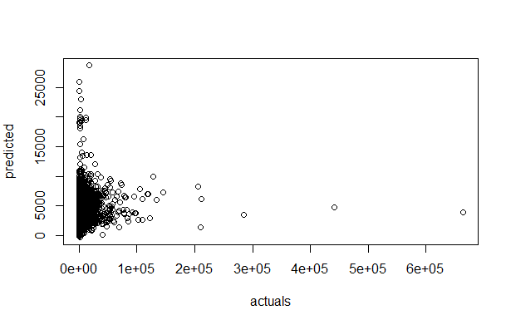
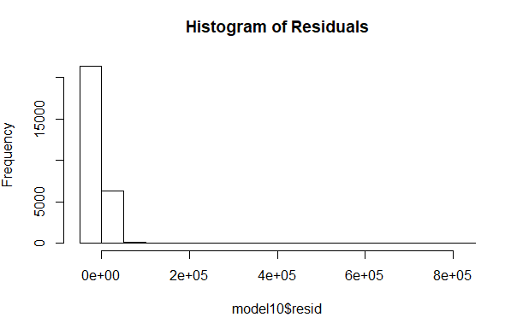
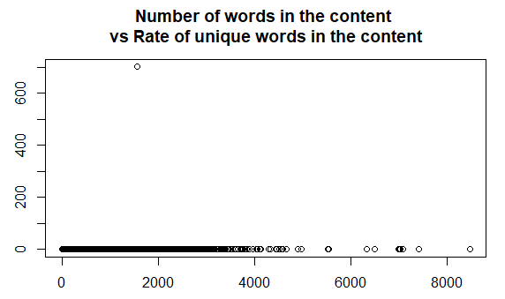
DATA REPRESENTATION USING MODEL A
Scatter plot for predicted shares vs actual shares
plot(actualprediction)
> hist(model10$resid, main="Histogram of Residuals")
> plot(trainingdata$n_tokens_content, trainingdata$n_unique_tokens, main="Number of words in the content + vs Rate of unique words in the content")

